Slide 1
PROBLEM Statement: Create a multifunctional fan that combines air purification, energy harvesting, and smart features for comfort and health
Smart Eco-Ceiling Fan
TEAM DETAILS:
TEAM NAME: Tech Titans.
COLLEGE: Parul University.
COURSE: B.tech – CSE.
MEMBERS: Member 1 – Majolika Singh.
Member 2 – Zarina Ambakhutwala.
Member 3 – Sonali Yadav.
DATE : 24/12/24

Slide 2
Scope of the Problem
Air Pollution:
A large source of respiratory disease comes from indoor air pollution.
In India, Times Now pointed out, nearly 30 percent of households still depend on biomass fuels, contributing to indoor pollution and health hazards such as chronic obstructive pulmonary disease.
Traditional fans run non-stop, consuming energy even when not needed, which results in higher electricity bills and additional carbon emissions.
The world population is continually increasing, which turns appliances into energy-efficient ones. For example article by BBC in 2023 said that energy consumption in the homes where inefficient appliances have been used has increased by 12% over the past decade.
Energy Consumption:
Conventional fans operate continuously, consuming energy even when not required, leading to increased electricity bills and unnecessary carbon footprint.
Vibrations from appliances are generally viewed as waste energy. So, tapping into this energy for label use, opens up even better possibilities for energy efficiency

Slide 3
Space Constraints:
As urban living spaces become more compact, the average size of apartments in major cities has decreased by about 5-10% over the last ten years. Multi-functional appliances are essential for maximizing limited space while still providing necessary functions.
Space-saving appliances can increase usable living space by as much as 40% making them perfect for homes under 1,000 square feet.
Health and Comfort:
Inefficiently designed appliances can lead to indoor air quality issues or poor temperature and humidity control, which can negatively affect health and comfort, hence regular updates can help increase awareness among the people.

Slide 4
Concepts, Theories, and Approaches
Activated Charcoal Filtration
Activated charcoal is widely used for the adsorbing or capture airborne pollutants like VOCs and PM2. 5
Ultrasonic Sensors
Ultrasonic sensors are sensors that emit high-frequency sound waves and measure if they bounce back, indicating the presence of a human.
This technology allows to switch on only when the room itself is being used, therefore eliminating waste of energy.
Vibration Energy Harvesting
Vibration energy harvesting principle: mechanical vibrations are converted into electrical energy using piezoelectric materials.
The vibration sensor is used to turn on a LED for a demo in the prototype.
In future designs the goal will be to store this energy in a capacitor to use it in different applications.
Temperature-Based Fan Control
The NPN with diodes and resistors create a circuit that changes fan speed with temperature.
This makes sure you have maximum comfort with minimum energy use.
LCD Display
An LCD shows real time environmental data like temperature and humidity

Slide 5
Financial details
COMPONENT NAME | COST(IN INR) | FUNCTION
DHT 11 MODULE | 80 | MEASURE TEMPERATUE AND HUMIDITY
VIBRATION SENSOR | 99 | CAPTURE MOTOR VIBRAATIONS
LEDS | 10 | LEDS
RESISTORS | 30 | RESISTANCE
LCD DISPLAY | 400 | DISPLAY TEMPRATURE AND HUMIDITY
BREAD BOARDS | 140 | CIRCUIT CONNECTION
WIRES | 80 | CIRCUIT CONNECTION
DC MOTOR, FAN,BATTERY | 100 | REPRESENT NORAML FAN
DIODES | 10 | FLYBACK PROTECTION
ULTRASONIC SENSOR | 60 | DISTANCE MEASUREMENT
TRANSISTORS | 10 | CONTROL SPEED OF FAN

Slide 6
Technical Specifications
COMPONENT NAME | FUNCTION
DHT 11 MODULE | USED TO MEASURE TEMPERATUE AND HUMIDITY
VIBRATION SENSOR | USED TO CAPTURE MOTOR VIBRAATIONS
LEDS | LEDS LIGHT UP WHEN THE FAN TURNS ON
RESISTORS | CREATE RESISTANCE IN CIRCUIT
LCD DISPLAY | DISPLAYS THE TEMPRATURE AND HUMIDITY
BREAD BOARDS | HELP IN CIRCUIT CONNECTION
WIRES | HELP IN CIRCUIT CONNECTION
DC MOTOR, FAN,BATTERY | REPRESENTS A NORAML FAN
DIODES | HELPS IN FLYBACK PROTECTION
ULTRASONIC SENSOR | USED FOR DISTANCE MEASUREMENT OF OBSTACLE
TRANSISTORS | CONTROL THE SPEED OF FAN

Slide 7
Flow of Operations
Air Purification
An activated charcoal filter captures harmful particles and pollutants from the air, improving indoor air quality.
Adaptive Operation
The ultrasonic sensor detects the presence of a person, ensuring that the fan is only in use when necessary.
This helps to avoid wasting energy when the space is empty.
Temperature-Based Speed Control
NPN transistor-based fan speed regulator using a temperature sensor.
As the temperature rises, fans run faster, lower temperatures mean slower.
Energy Harvesting
A vibration sensor can be used to obtain electrical energy from motor vibrations.
The vibration sensor is used to turn on a LED for a demo in the prototype.
In future designs the goal will be to store this energy in a capacitor to use it in different applications.
LCD display
the LCD display provides real-time updates on temperature and humidity, helping users to monitor indoor conditions.

Slide 8
Performance Estimates
Energy Efficiency
Can help reduce the energy consumption as compared ot the traditional fans as the wastage of energy will be reduced.
Air Quality Improvement
Removes pollutants with activated charcoal filter 5 particles in a variety of controlled environments.
Sustainability
Vibration energy harvesting may provide a way to reduce auxiliary power requirements.
Silent, energy-efficient air purification

Slide 9
Experimentation and Verification
Ultra-sonic Sensor Testing
several distances were tested against the ultrasonic sensor to ensure a consistent detection of the human body.
Temperature and humidity sensor testing
With the same guarantees, temperature sensor accuracy was controlled using a calibrated thermometer.
Energy Harvesting
Energy output was ascertained by measuring motor vibrations.
The energy produced powered an LED.
Fan Speed Control
the NPN was tested at different temperatures to validate the smoothness of the fan speed.

Slide 10
Uniqueness and Advantages
Innovation
A single appliance that combines air purification, adaptive energy-saving mechanisms and energy harvesting.
Sustainability
Repurposes wasted energy through vibration energy harvesting
Energy saving by intelligent control of fan speed
Scalability
A modular design also opens it up to extra features, including battery storage, or better mining sensors.
Can also be customized for commercial & industrial applications with larger capacity filters & sensors.
Health Benefits
Improves indoor air quality, helping to minimize the risks of respiratory and cardiovascular diseases.
It serves as a barrier against PM2 pollutants 5 and VOCs.

Slide 11
Environmental Impact
Helps you practice Sustainable living as we save energy.
Showcases novel trick of piezoelectric materials for energy harvesting.
Cost-Effectiveness
Provides an inexpensive option with a large scalability.
Operates intelligently to reduce energy bills.
User Convenience
Displays real-time environmental data on an easy-to-read LCD.
Intelligent Control The fan works automatically based on the user presence & environmental conditions.
Future-Ready Design
Integration with IoT systems for remote fan control and monitoring.
Future versions could have things like air quality monitoring or be customizable via an app.

Slide 12
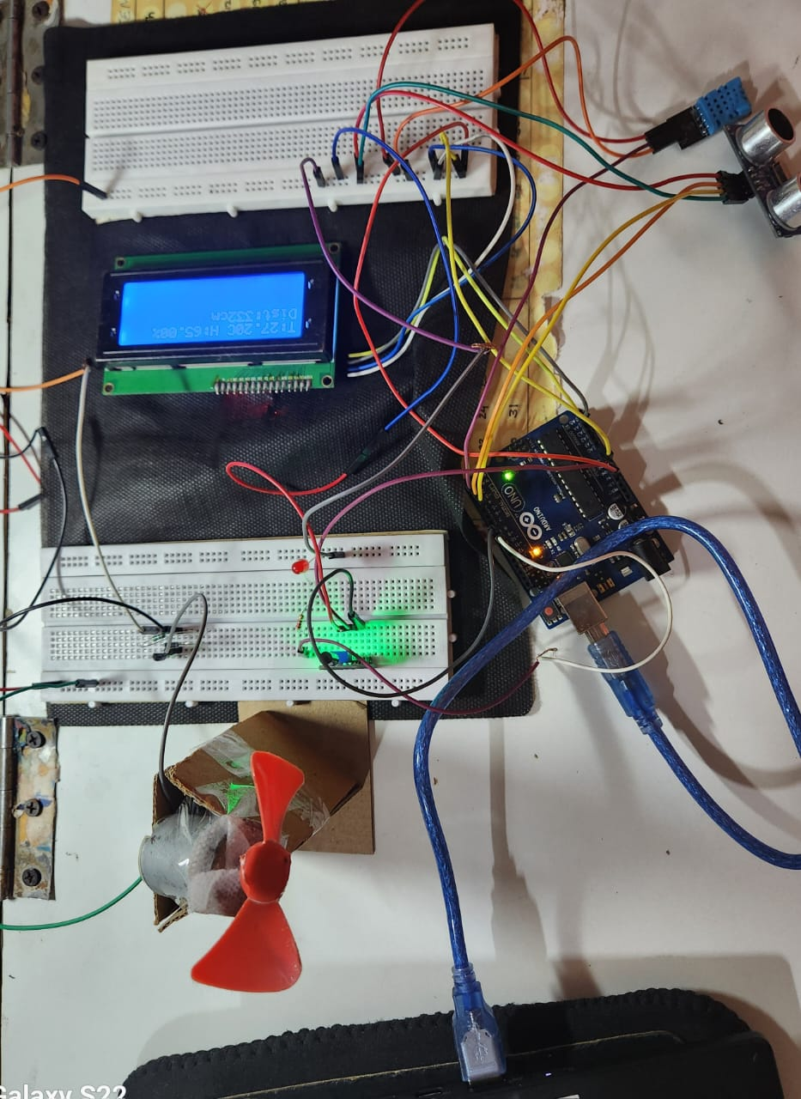
Prototype image and Code :
Code:
// Fan control pin int fanPin = 10; // PWM pin for fan // Timing variables unsigned long previousMillis = 0; const long interval = 2000; // 2 seconds for updates void setup() { // Initialize components lcd.init(); lcd.backlight(); lcd.setCursor(0, 0); lcd.print("Initializing..."); delay(2000); pinMode(led, OUTPUT); pinMode(vib, INPUT); pinMode(trigPin, OUTPUT); pinMode(echoPin, INPUT); pinMode(fanPin, OUTPUT); // Fan control pin dht.begin(); }

Slide 13
void loop() { unsigned long currentMillis = millis(); // Vibration sensor logic (no change from individual code) if (digitalRead(vib) == LOW) { // Vibration detected digitalWrite(led, HIGH); // Turn on LED delay(4000); // Keep LED on for 4 seconds digitalWrite(led, LOW); // Turn off LED } else { digitalWrite(led, LOW); // Ensure LED stays off } // Regular updates every 2 seconds if (currentMillis - previousMillis >= interval) { previousMillis = currentMillis; // Read DHT sensor data float temp = dht.readTemperature(); float hum = dht.readHumidity(); // Ultrasonic sensor distance calculation long duration; int distance; digitalWrite(trigPin, LOW); delayMicroseconds(2); digitalWrite(trigPin, HIGH); delayMicroseconds(10); digitalWrite(trigPin, LOW); duration = pulseIn(echoPin, HIGH); distance = duration * 0.034 / 2;
// Fan control logic if (distance <= 100) { // Object detected within 100 cm if (temp > 25) { analogWrite(fanPin, 255); // Full speed } else { analogWrite(fanPin, 128); // Half speed } } else { analogWrite(fanPin, 0); // Turn off the fan } // Display data on LCD lcd.setCursor(0, 0); if (!isnan(temp) && !isnan(hum)) { lcd.print("T:"); lcd.print(temp); lcd.print("C H:"); lcd.print(hum); lcd.print("%"); } else { lcd.print("DHT Error "); } lcd.setCursor(0, 1); lcd.print("Dist:"); lcd.print(distance); lcd.print("cm "); } }

Slide 14
SUMMARY
The Smart Air-Purifying Fan is an innovative solution to counter the dual challenges of indoor air pollution and energy inefficiency. This multi-functional appliance is designed to integrate activated charcoal filtration for superior air purification, ultrasonic sensors to adapt energy-saving functionality, and vibration energy harvesting to recover wasted energy. The fan adjusts its speed based on temperature using a transistor-controlled circuit, while providing real-time environmental feedback through an LCD display. With its modular design, sustainability features, and potential for scalability, this project reflects a blend of creativity, practicality, and technological advancement, positioning it as a forward-thinking solution to healthier and energy-efficient living.

Slide 15
THANK-YOU

